Slide 1
Pushdown Automata vs Turing Machine
Introduction, Differences, and Applications
Sagar Chhabriya
April 23, 2025

Slide 2
What is Theory of Computation (TOC)?
Branch of theoretical computer science studying the limits and capabilities of algorithms and models of computation.
Includes formal languages, automata theory, and complexity theory.
Formal languages model the structure of inputs like programming languages and mathematical notation.​

Slide 3
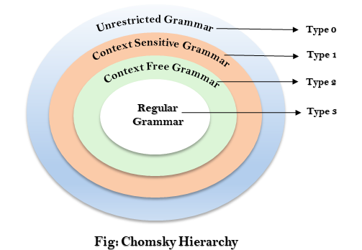
Types of Grammar Chomsky Hierarchy
Grammar Type | Grammar Accepted | Language Accepted | Automaton
Type-3 | Regular Grammar | Regular Language | Finite State Automaton
Type-2 | Context Free Grammar | Context Free Language | Pushdown Automata
Type-1 | Context Sensitive Grammar | Context Sensitive Language | Linear Bounded Automaton
Type-0 | Unrestricted Grammar | Recursively Enumerable Language | Turing Machine

Slide 4
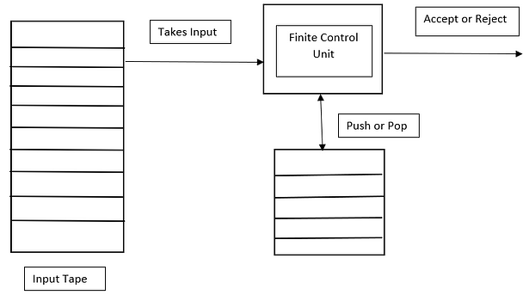
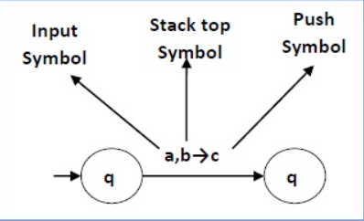
Pushdown Automata (PDA)
Finite automaton with an additional memory component: a stack.
Formal Definition: A 6-tuple (Q, Σ, Γ, δ, q₀, F)
Q: Set of states
Σ: Input alphabet
Γ: Stack alphabet
δ: Transition function
q₀: Initial state
F: Set of final states
Use Cases:
Parsing context-free languages, compiler design, natural language processing.

Slide 5
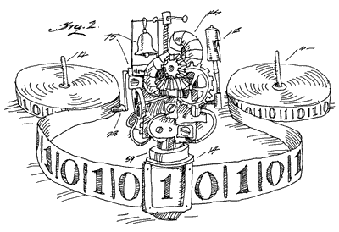
Turing Machine (TM)
Abstract machine with an infinite tape and a head that reads and writes symbols.
Formal Definition: A 7-tuple (Q, Σ, Γ, δ, q₀, B, F)
Q: Set of states
Σ: Input alphabet
Γ: Tape alphabet
δ: Transition function
q₀: Initial state
B: Blank symbol
F: Set of final states
Use Cases: Algorithm design, complexity theory, artificial intelligence.

Slide 6
Comparison: PDA vs TM
Feature | Pushdown Automata (PDA) | Turing Machine (TM)
Memory | Stack | Infinite tape
Language Class | Context-free languages | Recursively enumerable languages
Computational Power | Less powerful | More powerful
Acceptance Condition | Final state | Final state or tape content

Slide 7
Applications of Pushdown Automata
Parsing context-free grammars.
Compiler design (syntax analysis).
Natural language processing.
Tower of Hanoi:
https://www.mathsisfun.com/games/towerofhanoi.html

Slide 8
Applications of Turing Machines
Modeling computation and algorithms.
Studying computational complexity.
Artificial intelligence research.

Slide 9
Pushdown Automata are suitable for recognizing context-free languages and have applications in parsing and compiler design.
Turing Machines are more powerful, capable of recognizing recursively enumerable languages, and are fundamental in the study of computation.
Both models are essential in understanding the capabilities and limitations of computational systems.

Slide 10
References
Savale, P. (2023). Pushdown Automata vs Turing Machine: Introduction, Difference, Application. Medium. Retrieved from Medium Blog
YouTube​
https://automatonsimulator.com/

